Slide 1


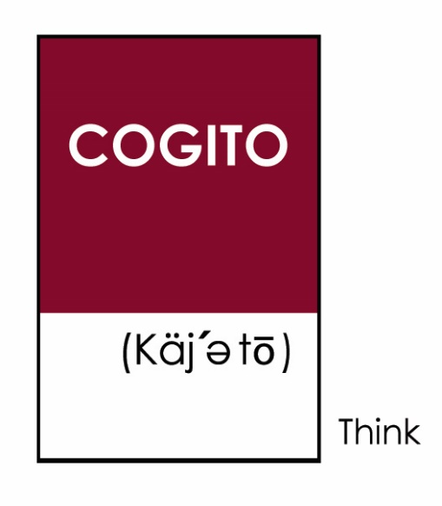
30th Avenue Active Transportation Plan
June 28, 2022
Community Open House
WELCOME!
Notes:
Becky
Housekeeping:
meeting being recorded & will be posted on website afterward
mute/cameras off
submit comments/questions via chat; we’ll respond as time allows, but we anticipate following-up after the meeting with more responses and information
Welcome
this is our final open house on this planning project
we value your participation in this process. It helps us make better decisions
our last public meeting in February was well-attended and we collected a lot of valuable feedback which has informed what we will be sharing with you today
Introduce PMT
County
Toole
Cogito

Slide 2
Agenda
Agenda
  4:00 – 5:00 PM Presentation Program
  5:00 – 6:00 PM Repeat Program
  Staff Presentation
    Project Overview – and public response to earlier designs
    Concept Designs – and revisions to respond to public concerns
  Next Steps
    Two-Week Public Comment Period
    Publication of Public Comment Results
Notes:
Becky
Similar to our last meeting
we have two back-to-back sessions
with one starting at 4:00
and then repeating again at 5:00.
We have revised designs to share with you which is the focus of the meeting
We’ll provide an overview of the project –and will describe how we are focusing our efforts to address more immediate needs and safety concerns
We believe that what we have developed designs that
Address priority issues
Balances a lot of interests and concerns
And allows for incremental changes as more is known about development, growth, and traffic patterns
After hearing and seeing what we present tonight, if you have more questions or concerns, we invite you to contact me.
We’ll be providing a 2-week comment period after tonight’s meeting
We’ll go over next steps in more detail toward the end of the meeting

Slide 3
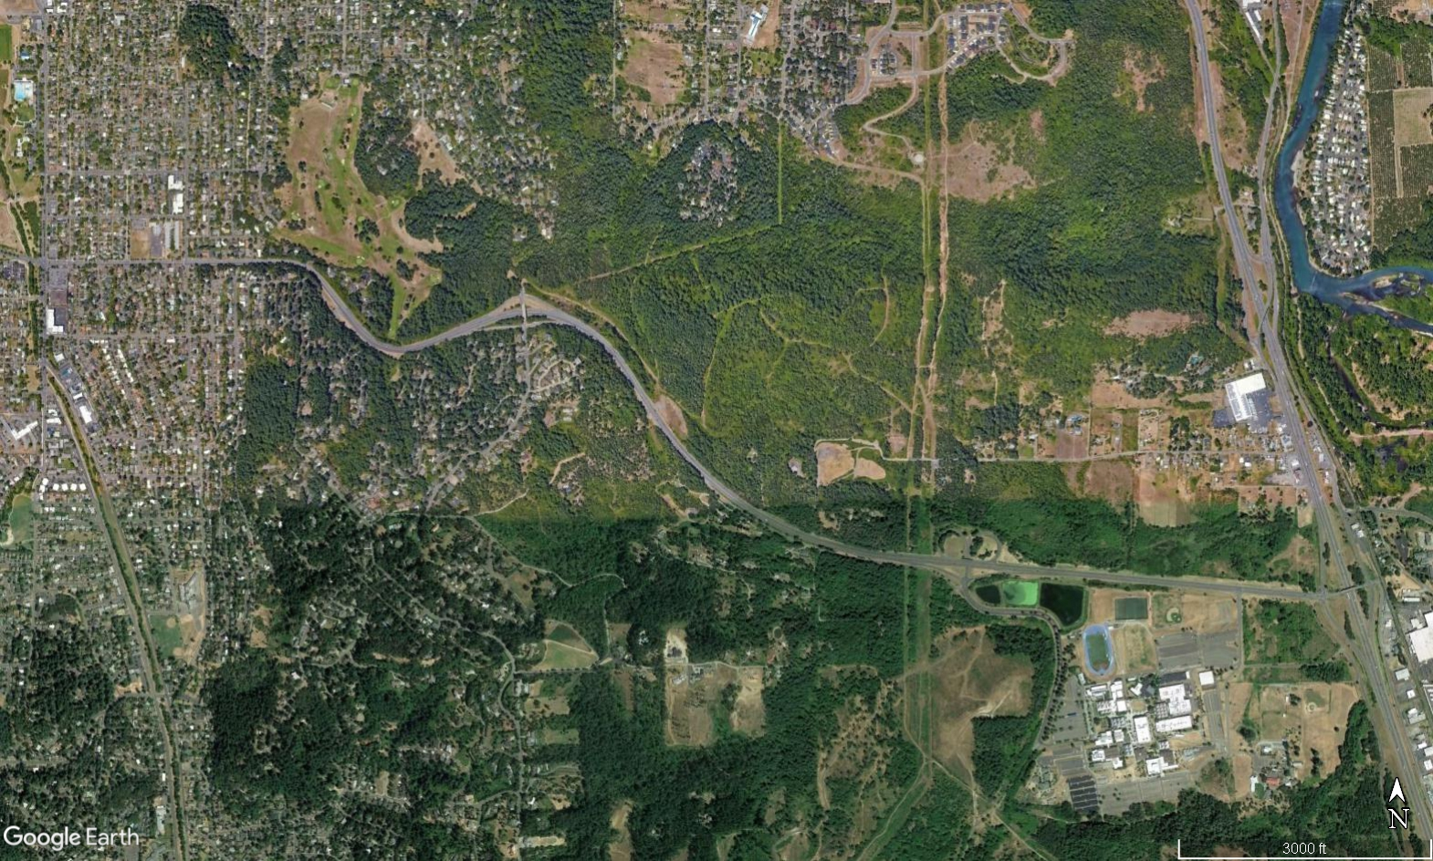
Project Focus: 30th Avenue (Agate – McVay)
Hillyard St
Improve Safety for All Roadway Users
Agate St
Connect to Existing Facilities
Spring Bl
Future Connections
Forest Blvd
(Frontage Rd)
McVay Hwy
Gonyea Rd
Eldon Schafer Rd
I-5
LANE CC
The immediate (interim) focus is improving safety on 30th Avenue (between Agate Street and McVay Highway) for all roadway users (people driving, walking, riding a bike, taking transit)
Notes:
Becky
Like most planning processes, we began with an aspirational vision of
“reimagining” 30th Avenue,
creating a “vibrant” corridor,
and making it “comfortable”
for “all ages and abilities”
The point of a planning process is to explore possibilities, but also constraints.
We collect and evaluate data and public input to ground-truth what’s most important and necessary.
We have experienced a reality-check with this project.
First, and foremost, we need to improve safety for all roadway users for people walking, riding, driving.
Lane County has made a commitment to work toward Zero Deaths on our roadways
We have identified safety risks and roadway design changes to minimize that risk
We know 30th is a steep hill, which makes for a challenging bike ride, so we know this isn’t a
“comfortable” facility
We also can’t realistically make this an “all ages and abilities” facility
This is a Lane County project, so we are focused on what’s within Lane County’s control
The portion of 30th Avenue under Lane County’s jurisdiction is between Spring Blvd and Eldon Schafer
We’re working with the City of Eugene for connections west of Spring Blvd
And with ODOT east of Eldon Schafer
Lane County’s plan isn’t going to dictate what happens on Eugene or ODOT facilities, but the staff discussions with those agencies have been supportive of the planning process and our recommendations
We’re focused on realistic, incremental change
We’re working toward Better rather than Perfect

Slide 4
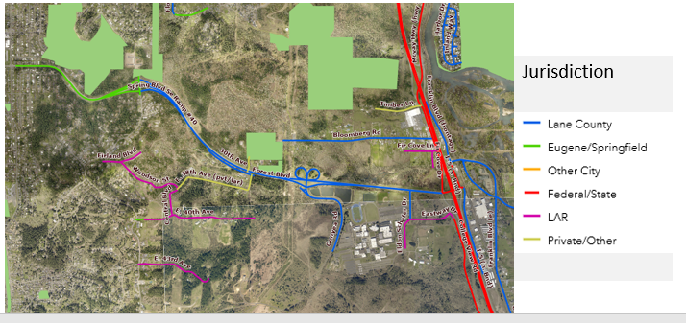

Coordination for Making Connections
Eugene
Eugene Parks
ODOT
LCC
Lane County has jurisdiction of 30th Avenue between Spring Blvd. and Eldon Schafer Drive
Notes:
Becky
In addition to the mixed roadway jurisdiction in the area, we’ve also been consulting LCC and Eugene parks about improving connections and access to their facilities which are key destinations on 30th Avenue.
Eugene has acquired additional parkland north of 30th Avenue

Slide 5
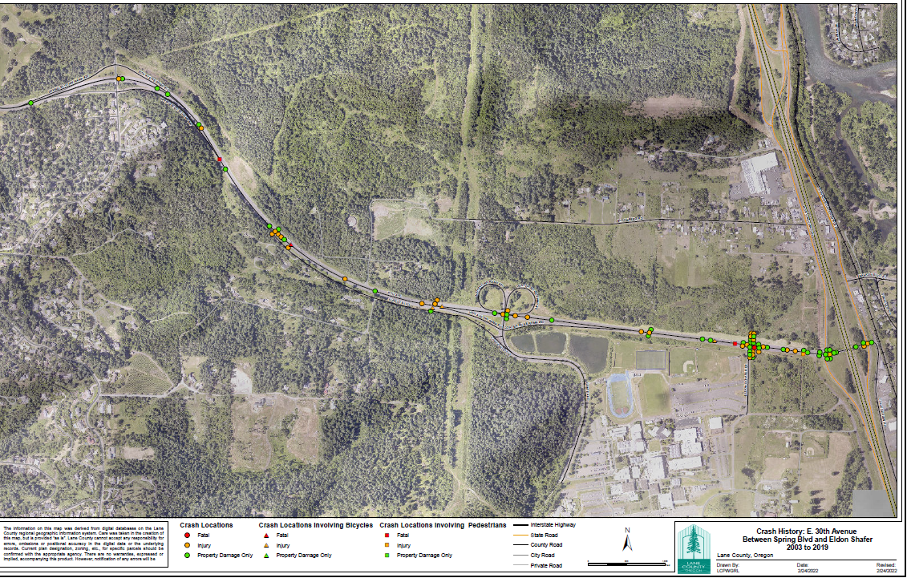
Safety Problem
More people have died or been injured while walking and biking 30th than any other road under Lane County’s jurisdiction
30th Avenue Crashes (Spring Blvd. - Eldon Schaffer)
(2003 – 2019)
88 crashes total
4 people died – two while walking and 1 bicycling
55 people injured – 3 while biking and 1 while walking
Notes:
Becky
Several people have told me “I’ve never seen any crashes on 30th Avenue”
This is where data is important to supplement perspectives
The crash data confirms a safety problem on 30th Avenue
More people have died or been injured while walking or biking on 30th Avenue than any other road under Lane County’s jurisdiction (more than Territorial Highway or Row River Road).
I’ve heard people say “no one will walk or bike 30th because it’s too steep” but the fact is that people are walking and biking it. And too many people have died or been injured while walking or biking 30th.
Harm is also happening to people driving -- especially at the intersections of Forest Blvd and Eldon Schafer Drive
There are engineering solutions to minimize and mitigate the frequency and severity of these crashes.

Slide 6
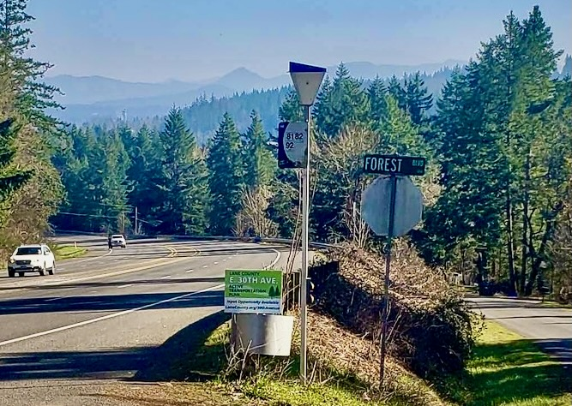
Public Input Summary
  Events
  Stakeholder Interviews
  Focus Groups (Thru-Users, Education, Recreation) #1
  Community Visioning Workshop
  Focus Groups (Thru-Users, Education, Recreation) #2
  Community Open House # 1
  Community Open House # 2
Outreach (* = bilingual materials)
Lawn signs*, postcards, community news bulletins/media*, presentations, project fact sheet*, social media*, La E-Kiss*, and E-updates.
Notes:
- Project team began with stakeholder interviews to confirm PI plan would reach intended audiences
Series of focus groups prior to open houses for initial review of public materials, understand any issues/considerations/questions to address in the public meetings
Held two public meetings prior to this evening to help inform design considerations.
Add here how many personal emails, phone calls you responded to during the process!
Listed here are the outreach methods and bilingual materials(*) we used to make sure the project had broad community representation.

Slide 7
Public Comment Summary
Support for Change
  33% (52 out of 160 people) voted to Do Nothing
  67% (108 out of 160 people) voted for change
Key Concerns
  Protection for people walking and biking
  Vehicle lane reductions
  Safety at intersections
  Land development and traffic
  Eugene and ODOT Facilities
Notes:
The input we have received from the community has been incredibly helpful.
From public meetings, emails, on-line surveys, we’ve received about 200 comments
Most people – about 108 people -- have said they do want to see changes made to 30th Avenue and that they’re concerned about the safety of the existing roadway.
Several people – about 52 people – have said they like 30th just the way it is and don’t want to see any changes. Most of the objections to change are concerns about reducing the number of vehicle travel lanes.
Other common comments were directed at City of Eugene land development and 30th at Agate and to the west, and about Oregon Department of Transportation (ODOT) facilities to the east, such as McVay Highway and the 30th bridge over I-5.

Slide 8
Public Comment Response
Postpone Rebuild Alternative
  Eugene proposing to include area for potential future residential development
  Reconstructing roadway needs to consider development needs/impacts
Focus on Interim Design Revisions
  Safety
    Roadway designs that mitigate high-risk crash types (T-bone and head-on) and intersections (Forest Blvd and Eldon Schafer Dr.)
    Protect vulnerable users (people walking and biking)
  Equity
    Expand transportation options and access to LCC
    Address historical underinvestment in walking and biking for people who lack reliable access to cars
Notes:
Our team reviewed and discussed all of the public comments.
A more detailed summary of comments received and staff responses is posted in a 64-page document on the project webpage.
The changes we are recommending on 30th Avenue are intended to balance these public interests and address priority safety risks.
A key decision is to postpone what we had identified previously as the Rebuild Alternative which proposed reducing the number of vehicle travel lanes to one in each direction and replacing the on/off ramps at Spring Blvd and Goneya Blvd with roundabouts. We recommend postponing major reconstruction changes to a future process when more information is known about development needs and impacts associated with the City of Eugene’s Urban Reserve process.
Instead we are focusing on an Interim Design to meet priority safety and equity needs.

Slide 9
Interim Design: Revised
Hillyard St
Agate St
Spring Bl
Forest Blvd
(Frontage Rd)
McVay Hwy
Gonyea Rd
Eldon Schafer Rd
I-5
LANE CC
Original: Shared-use path on south side of 30th between Agate and Forest; use Forest to Gonyea; reduce downhill vehicle traffic to one lane.
Revised: Add shared-use path between Gonyea and Eldon Shafer; keep all four vehicle lanes; add center turn lanes at Forest/30th and Bloomberg/30th; add roundabout at Eldon Schafer/30th.
Recommend: Eugene consider roundabout at Agate; ODOT consider warning lights on 30th/1-5 bridge until replaced/widened; future study for off-road connections through LCC/Parks.

Slide 10
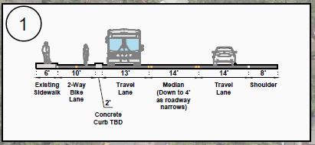
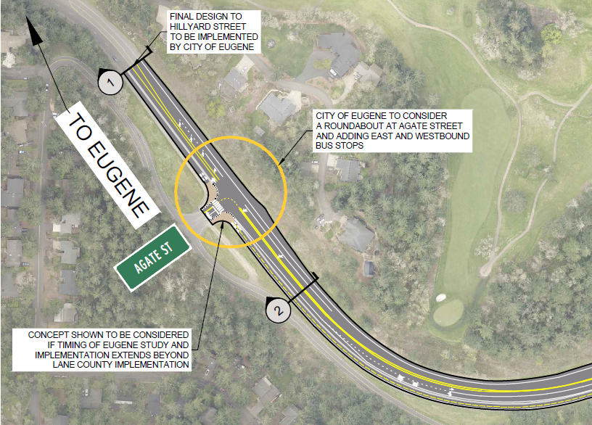
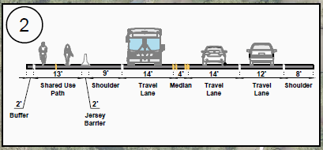
Interim Design Option (at Agate)

Slide 11
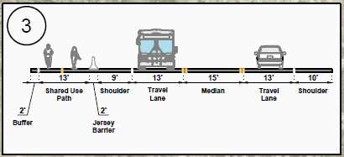
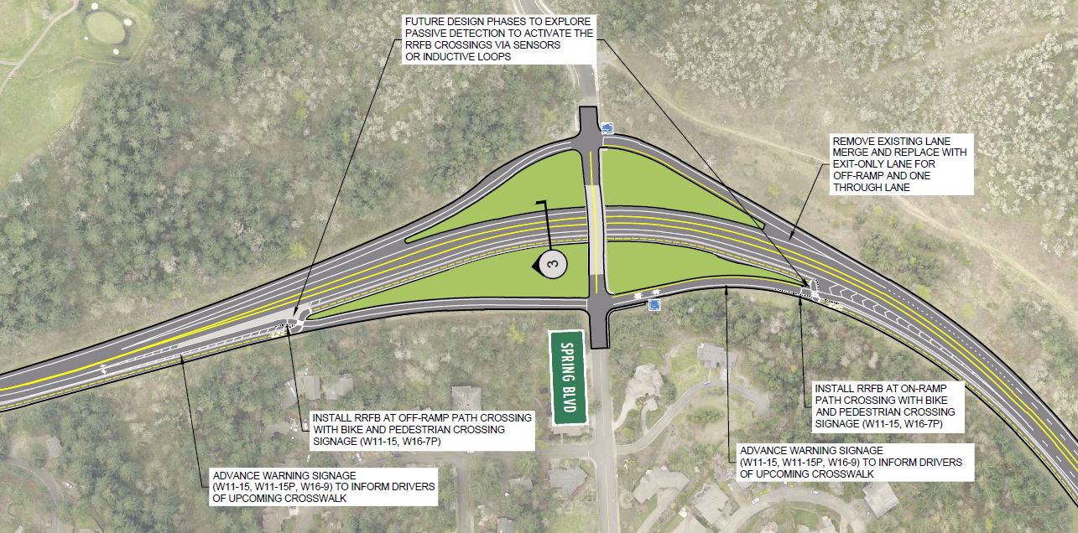
Interim Design Option (at Spring)

Slide 12
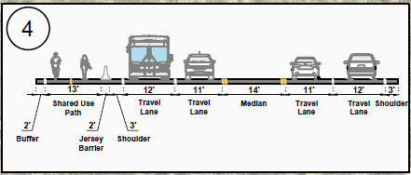
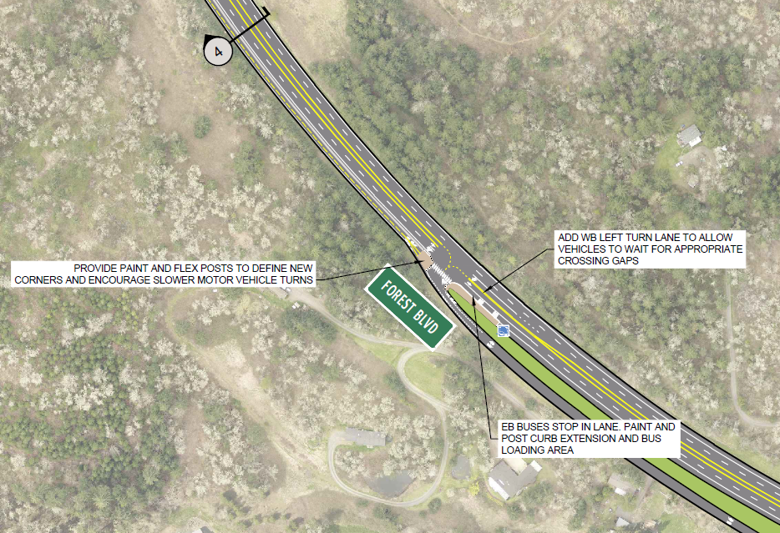
Interim Design Option (at Forest)

Slide 13
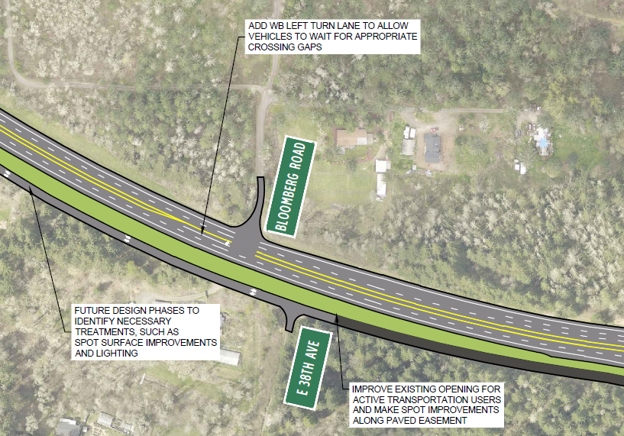
Interim Design Option (at Bloomberg)

Slide 14
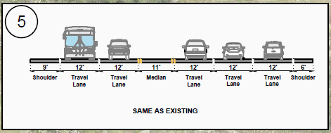
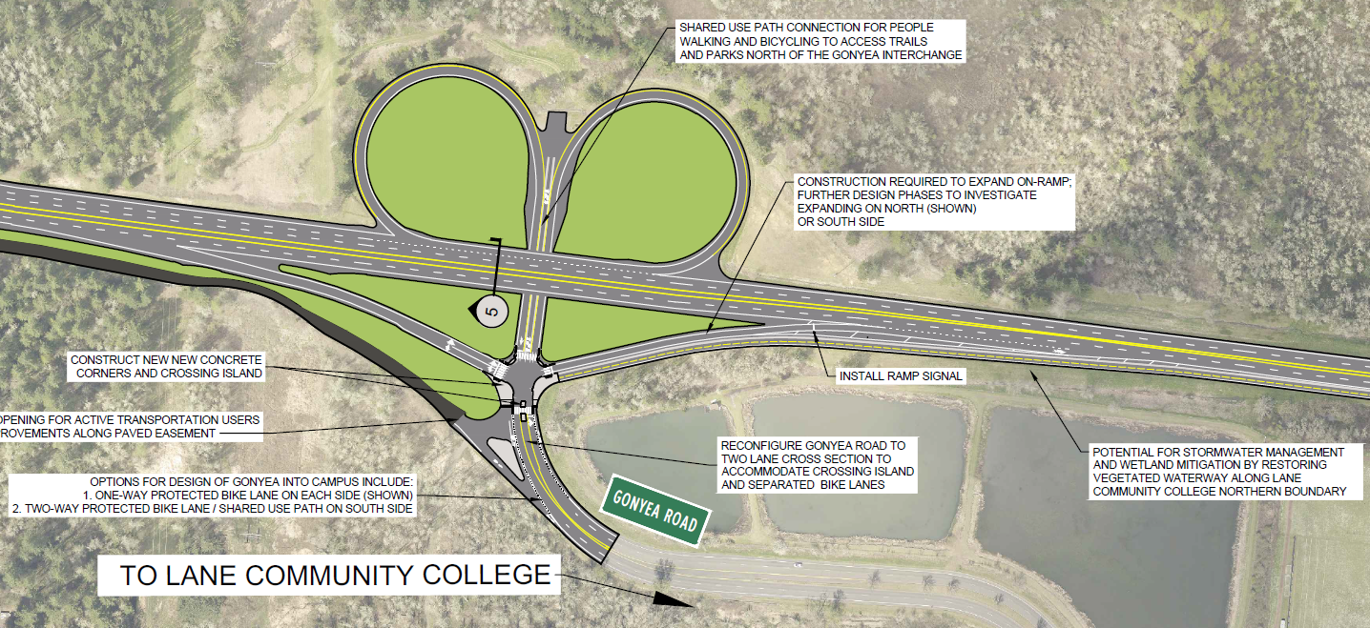
Interim Design Option (at Gonyea)

Slide 15
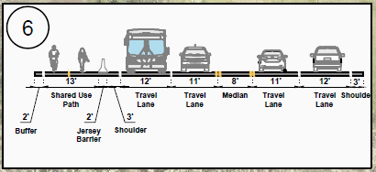
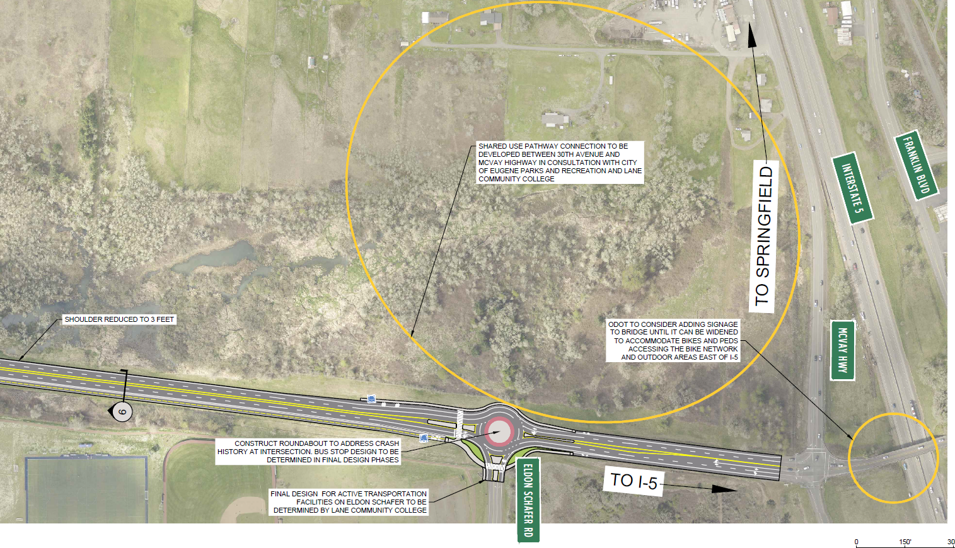
Interim Design Option
(at Eldon Schafer)

Slide 16
Next Steps
Post-Meeting Comment Period
  Submit comments/questions by July 12th
  Staff summary/response by July 26th
Transportation Advisory Committee
  Review/discuss design details on July 27th
  Public Hearing on September 28th
Board of County Commissioners
  Final decision on design concept (winter)
Notes:
A change to the schedule from my latest email to interested parties: on July 27th, we’ll just be presenting the recommendation to the committee to prepare them for a public hearing September 28th. We’ll send out more notices of the public hearing.

Slide 17
Future Steps: If Design Concept Approved
Secure Funding for Design Refinement
  Need additional funding for more engineering analysis and design refinement
  Target 2024-2027
Secure Funding for Construction
  Construction funding has not been identified
  Soonest 2027
Rebuild/Urban Reserve
  Eugene in planning process
  Planning 27 years out (2049)

Slide 18
Issues to Review
During Design Refinement
Posted Speed
Wildlife Crossings
Freight Movement
Lighting
Median Treatments, such as barriers and turning lanes
Intersections
Safety of people walking and biking in shared space
Bus Stops
Environmental

Slide 19
Please Visit www.lanecountyor.gov/30thAvenue
Comments/Questions
Becky Taylor, Lane County Project Manager
becky.taylor@lanecountyor.gov
541.682.6932
Notes:
Becky

